Slide 1
Taxes on Sales and Purchases

Slide 2
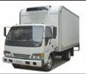

Taxes on Sales and Purchase
Purchase
Sales
Balance
Tax
Sheet
Notes:
This In-house course was developed to meet the needs of SAP R/3 Consultants working at Capgemini. This course is designed to present a high level view of Sales & Distribution Module.
More in-depth courses have been developed to train Consultants in specific areas discussed during this course.
Your comments at the conclusion of this training session are appreciated and will help us better tailor future courses to meet your training needs.

Slide 3
Lesson Objectives
Purpose
Use
Challenge
Tax Process flow and Description
Tax Calculation
Tax Codes
Tax Postings
Specification in G/L Accounts
Tax for Down Payments
Tax Reporting and Examples
Notes:
Explain the lesson coverage

Slide 4
Purpose
Taxes on sales and purchases are levied on every sales transaction in accordance with the principles of VAT.
This applies to input and output tax.
Purchase tax -
VAT on a taxable entity’s purchases or expense, which normally may be offset against sales tax. It is calculated using the net invoice amount and is charged by the vendor.
Sales tax -
VAT on a taxable entity’s sales is Sales tax. It is charged to the customer.

Slide 5
Use
Tax Calculation
Tax Posting
Performing tax adjustments
Tax reporting

Slide 6
Challenges
Understand the concept of Purchase & Sales Tax
Understand the configuration requirements for Purchase and Sales Tax
Understand how to manage various types of tax
Understand how the tax types would be used for calculating, posting and correcting tax
Understand how to do tax reporting

Slide 7
Taxes on Sales and Purchase
Process Flow

Slide 8
Taxes on Sales and Purchase
Process Description
1. Calculation Procedure
A tax calculating procedure is assigned to every country for carrying out tax calculations. Standard SAP is having tax calculating procedure for most countries.
A tax calculating procedure consist of :-
Order of the steps
Tax types or condition types
Account or transaction key

Slide 9
Taxes on Sales and Purchase
Process Description
2. Tax codes
The Tax code is used to :-
Check the tax amount on sales/purchase document
Calculate the tax amount
Verify the tax type
Determine the GL account
Show tax correctly on tax forms & reports

Slide 10
Taxes on Sales and Purchase
Process Description
3. GL account – Tax Category
We define the tax accounts to automatically post the tax amount to the GL account. In this account, we enter the Tax category by entering on of the following indicator :-
< for input tax
> for output tax

Slide 11
Taxes on Sales and Purchase
Process Description
GL account – Tax Category
GL Account = Tax Category
GL account
GL
account
GL account
Allowed
OUTPUT TAX
OUTPUT TAX
tax codes
:
>
A0
Tax type A
Tax category
>
A1
:
A2
can only be posted
:
to automatically
X
GL account
GL account
OUTPUT TAX
INPUT TAX
V0
:
<
V1
Tax type V
Tax category
<
V2
:
:
can only be posted
to automatically
©
SAP AG
1999

Slide 12
Taxes on Sales and Purchase
Process Description
4. Tax account determination
To enable the automatic tax account determination, we need the following prerequisites :-
Posting Keys
Rules
Tax accounts

Slide 13
Taxes on Sales and Purchase
Process Description
5. Document – Tax information
Tax calculated by the system is usually posted via a separate line item in a document.
In some cases it further distribute tax amount to the relevant expense/revenue items.
In some cases, even details for exempted sales/purchase is also recorded for information purposes.

Slide 14
Taxes on Sales and Purchase
Process Description
6. Tax Reporting
In SAP, there is country specific tax reporting available.
In most of the countries periodic return for tax on sales & purchase is required.
In some countries, tax-exempt Purchase & sales is also required to be submitted to the tax authority.
In some cases, sales made to member countries is also required to be reported i.e. EC sales list.

Slide 15
Taxes on Sales and Purchase
Tax Calculation
Before making configuration for the calculation of Tax on sales/purchase you have to check the standard procedure provided by the SAP for the relevant country.
SAP provides standard calculation procedure for most of the countries which you can use.
However you can make the changes in condition type etc. if it is specifically required.

Slide 16
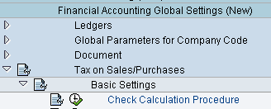

Taxes on Sales and Purchase
Tax Calculation :-
Before Going for Tax configuration, you should check the calculation procedure provided by the SAP. Standard SAP provide tax calculation procedure for most of the countries.
You have to assign the Calculation procedure to your country

Slide 17
Taxes on Sales and Purchase
Tax Calculation :-
The Financial Accounting components Accounts Receivable, Accounts Payable and General Ledger provide the following comprehensive tax functions:
Tax calculation -
The system calculates tax amounts with or without cash discount based on the tax base amount.
Tax codes are used to calculate and check the amounts.

Slide 18
Taxes on Sales and Purchase
Tax Calculation :-
Tax posting
The system posts the tax amounts to defined tax accounts.
Adjustments
The system corrects tax amounts, in the case of cash discount or other deductions, for example.
Tax reporting
You can use the system to create tax returns.

Slide 19
Taxes on Sales and Purchase
Tax Codes :-
You have to define a separate tax code for both sales & purchases for the country in which your company code is located
Each Tax code can contain one or more tax rates for the different tax types
For reporting Exempted/Non taxable transactions to the Tax authority, you need separate Tax code with 0 % tax rate
In some countries, you have to assign reason for zero tax rate for the reporting purpose

Slide 20
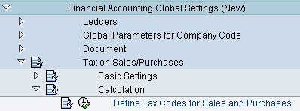
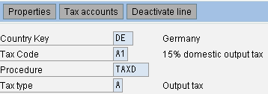

Taxes on Sales and Purchase
Tax Codes (OB40) :-
Tax code contains type of tax, percentage and GL account to which the
tax amount will be posted to.

Slide 21
Taxes on Sales and Purchase
Tax Codes :-
Tax codes are used to:
Check the tax on sales/purchases amount in the document
Calculate the amount of tax on sales/purchases automatically on request
Calculate the non-deductible input tax portion
Check if a tax account with tax type (input or output tax) can be posted to
Determine the tax account

Slide 22
Taxes on Sales and Purchase
Tax Postings:-
When posting a document, the system creates the tax items automatically. The data required to do this, the posting key, and the account number of the tax account must be defined in the system.
The posting keys are already defined in the system. The accounts vary according to the chart of account, and to post taxes in the system you must therefore define the account numbers of your chart of accounts.
To enable the tax accounts to be specified, an account key has been assigned to the tax types. You enter your tax accounts in the system for each chart of accounts and account key. You enter a tax account for all three tax types.

Slide 23
Taxes on Sales and Purchase
Tax Postings:-
You can distinguish tax accounts by tax codes. That is, you can determine whether for a tax transaction represented by an account key, a single tax account should always be posted to, or separate accounts according to the tax code in each case. Since the advance return for tax on sales/purchases is created from the documents, you do not need to differentiate tax accounts according to tax code.

Slide 24

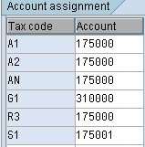
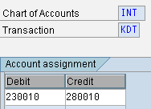
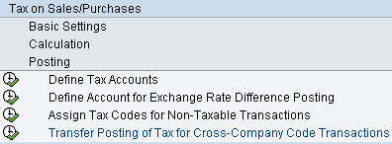
Taxes on Sales and Purchase
You specify the accounts to which the different tax types are posted to. Further you have to define GL accounts for Exchange rate difference and cross company postings of Tax.

Slide 25
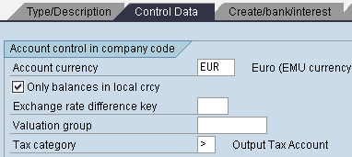

Taxes on Sales and Purchase
Specifications in the GL accounts
You can make specifications for calculating, checking, and posting taxes on sales/purchases in three fields in G/L accounts. These are:
Tax category
By means of this field, you determine in the master record of a G/L account whether the account is a tax account, a tax-relevant G/L account, or a G/L account that is not tax-relevant.
For a tax-relevant G/L account, you can determine the tax
codes that can be used to post to the account.

Slide 26
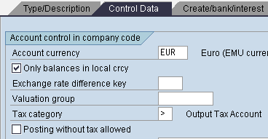
Taxes on Sales and Purchase
Specifications in the GL accounts
Posting without taxes allowed By means of this field, you can indicate the accounts that are tax-relevant, but for which posting of non-tax-relevant transactions without a tax code is allowed.

Slide 27
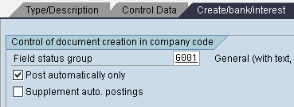
Taxes on Sales and Purchase
Specifications in the GL accounts
Automatic posting only For each account, you can use this field to determine whether you want to have the account posted to by the system only, that is automatically, or manually as well.

Slide 28
Taxes on Sales and Purchase
Tax on Sales/Purchases for Down Payments
Down payments are posted to special reconciliation accounts which are special G/L accounts in the system.
The legal specifications determine whether or not tax on sales/purchase is to be posted for down payments. If as a general rule you do not post any tax on sales/purchases , you can hide the fields for the tax specifications. You do this via the special G/L account which is a down payment account.
You can create the master records with an account group for which the Tax category field does not appear. When creating the master record, you will not be able to make an entry in this field.
The tax category field can also be left blank in the master record. All fields for tax on sales/purchases are then hidden on the entry screens.

Slide 29
Taxes on Sales and Purchase
Tax on Sales/Purchases for Down Payments
There are two method for Tax on Sales/purchase for Down Payments :-
1. Net display and
2. Gross display
In net display method, the tax is posted to the tax account and down payment is posted minus tax amount.
In gross display method, the down payment posted is including tax amount. Here also tax amount is posted to a tax account but to clear the tax it is automatically posted to the clearing account.

Slide 30
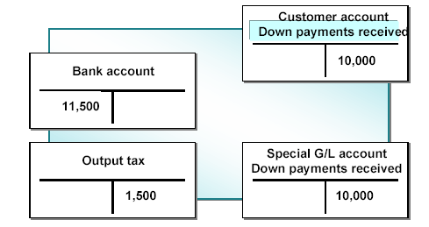
Taxes on Sales and Purchase
Tax on Sales/Purchases for Down Payments
For example if you receive 11,500 local currency from your customer as a Down Payment including 1,500 as a tax. The entry under net procedure will be as under :-

Slide 31
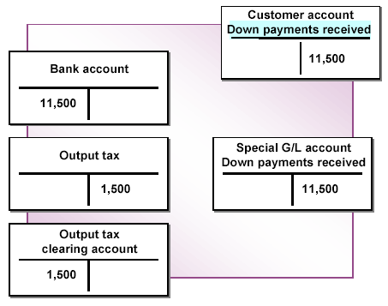
Taxes on Sales and Purchase
Tax on Sales/Purchases for Down Payments
The entry under gross procedure will be as under :-
Gross display has the advantage that the down payment amount is displayed in the open item
accounts including the taxes on
sales/purchases.

Slide 32
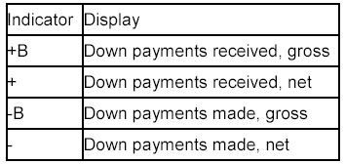
Taxes on Sales and Purchase
Tax on Sales/Purchases for Down Payments
Indicators for displaying taxes :-

Slide 33
Taxes on Sales and Purchase
Tax Reporting
You are required to create an advance return for tax on sales/ purchases on a regular basis, and to do this you can make use of the various country-specific programs in the R/3 System.
To credit the tax accounts, you must transfer the tax amounts to a tax payable account by:
Creating the postings using the program for the advance return
for tax on sales/purchases
Posting the tax amounts manually to a tax payable account
using the Tax payable function

Slide 34

Taxes on Sales and Purchase
Examples :-
Posting Output Tax
You post an outgoing invoice to the sum of 1150 local currency with 15 % output rate. The invoice amount, including tax, is automatically posted to the customer account; the tax amount (150 local currency) is automatically posted to the output tax account.

Slide 35

Taxes on Sales and Purchase
Examples :-
Posting Input Tax
You post an incoming invoice with an invoice amount of 1150 local currency with 15 % input rate. The invoice amount, including tax, is automatically posted to the vendor account; the tax amount (150 local currency) is automatically posted to the input tax account.

Slide 36
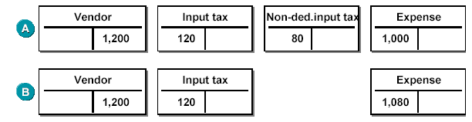
Taxes on Sales and Purchase
Examples :-
3. Posting Non-Deductible Input Tax
You have to post an incoming invoice of 1,200 local currency. The tax amount of 200 local currency comprises of 12 %input tax and 8% non-deductible portion. You can post the non-deductible portion either to a separate account (figure A) or distribute it to the GL account /asset line item. figure B)

Slide 37
Taxes on Sales and Purchase
Tips and Tricks :-
Here are some Tips & tricks which you can use to simplify your configuration work :-
Don’t forget to tick check box" post automatically only” in Tax account if you want that tax amount should not be posted manually.
You should choose the tax calculation without jurisdiction codes if your business partners’ locations are restricted to few jurisdiction. That way you can simplify the procedure by directly assigning the percentages rate to the different tax codes.

Slide 38
Taxes on Sales and Purchase
Tips and Tricks :-
You should choose the tax calculation with jurisdiction codes if you have business relationships with companies having locations spread over many jurisdictions, or if it is expected in the future.
Once you have chosen one tax calculation method, you cannot change the same.

Slide 39
Taxes on Sales and Purchase
Additional Information :-
Some of the important links for help :
http://help.sap.com/
http://www.sap.com/

